Slide 1
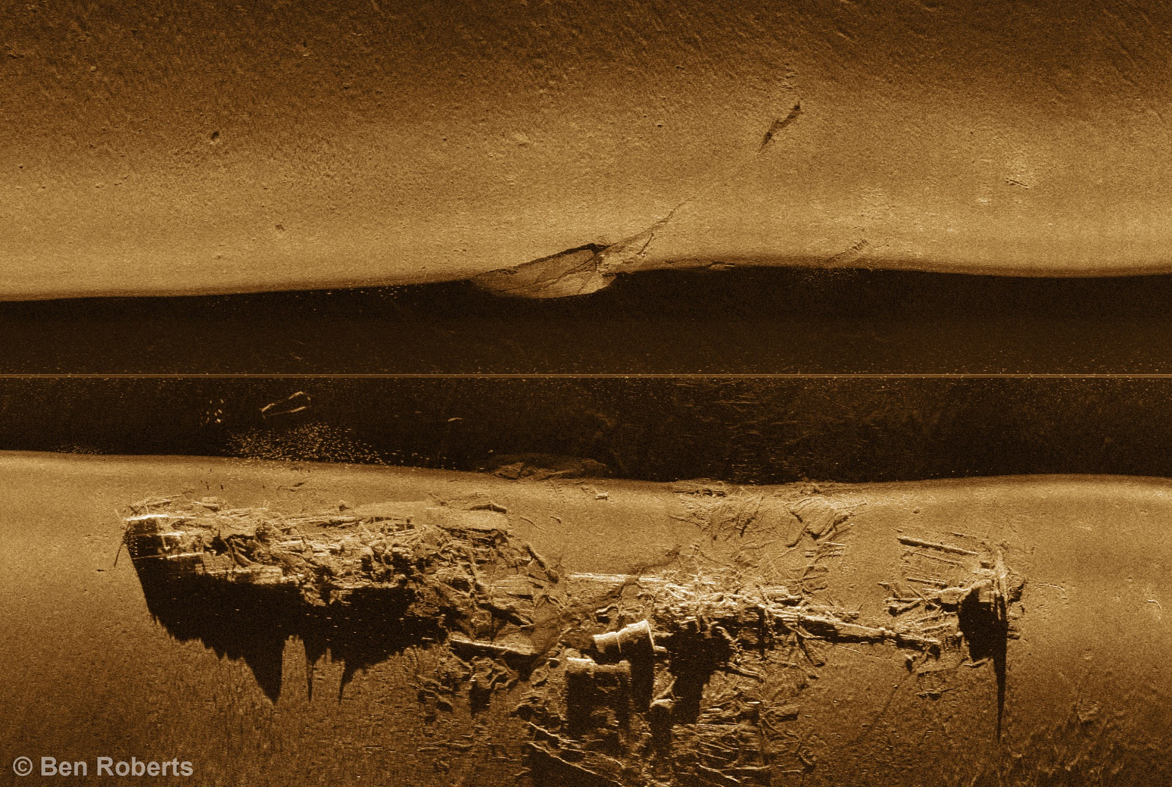
On Python and Positioning
An Introduction to Working with Geospatial Data in Python with GeoPandas and folium
NH Python Group December 2021

Slide 2

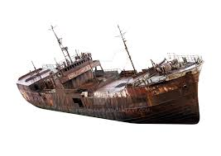
This Evening’s Quest
Dataset Overview
Python Packages
Code Demo
Geospatial Ecosystem & Theory
Geospatial Enlightenment!
Sources: - Cover photo: Sonar image of the SS Biela via Eastern Search & Survey © Ben Roberts, used with permission - All clipart, except where noted, is from Clipart-library.com, licensed for personal use

Slide 3
Dataset Overview
National Oceanic & Atmospheric Administration (NOAA)
Three public datasets of NOAA’s collection of known wrecks and obstructions in US coastal waters
Automated Wreck and Obstruction Information System (AWOIS) wrecks, AWOIS obstructions, and Electronic Navigational Chart (ENC) wrecks
https://nauticalcharts.noaa.gov/data/wrecks-and-obstructions.html
Eastern Search & Survey (ESS)
ESS provided coordinates for several hang logs involved in the search for the SS Biela wreck, as well as details and backstory of the search
https://www.facebook.com/Eastern-Search-Survey-109413857123876

Slide 4


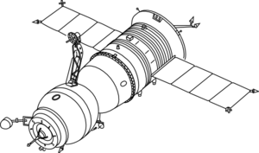

The Geospatial Ecosystem: Geographic Information Systems (GIS)
A GIS is a computer-based system to aid in the collection, maintenance, storage, analysis, output, and distribution of spatial data and information – this can include hardware, software, data, people, and industry protocols¹
Industry Protocols
GIS Software
Open Geospatial Consortium (OGC)
Data Collection
Data Storage
OSGeo Projects: GDAL/OGR, GEOS, PROJ
Desktop Apps: QGIS, ArcGIS, others
Python packages
Note: 1. Bolstad, Paul. GIS Fundamentals: a First Text on Geographic Information Systems. 6th ed., XanEdu, 2019.

Slide 5
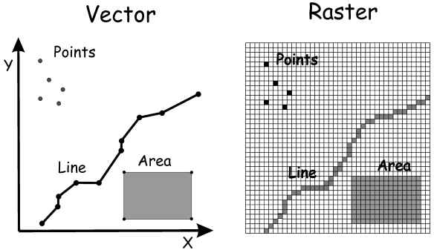
Overview of Geospatial Data Models
Vector Data
Raster Data
Discrete geometries
Points, lines, polygons described by coordinates
Continuous, “gridded” data with embedded coordinates
Elevation, satellite images, ground cover

Slide 6
Geospatial Data Models
File Format Examples
Vector Data
Shapefile (.shp/.dbf/.shx/.prj)
GeoJSON (.json), KML (.kml)
~90 supported by OGR
Raster Data
GeoTIFF (.TIF or .TIFF)
Image (.img)
>200 supported by GDAL
Data Attribute Tables
Any attribute tied to a location or geometry
CSV (.csv)
Database table

Slide 7
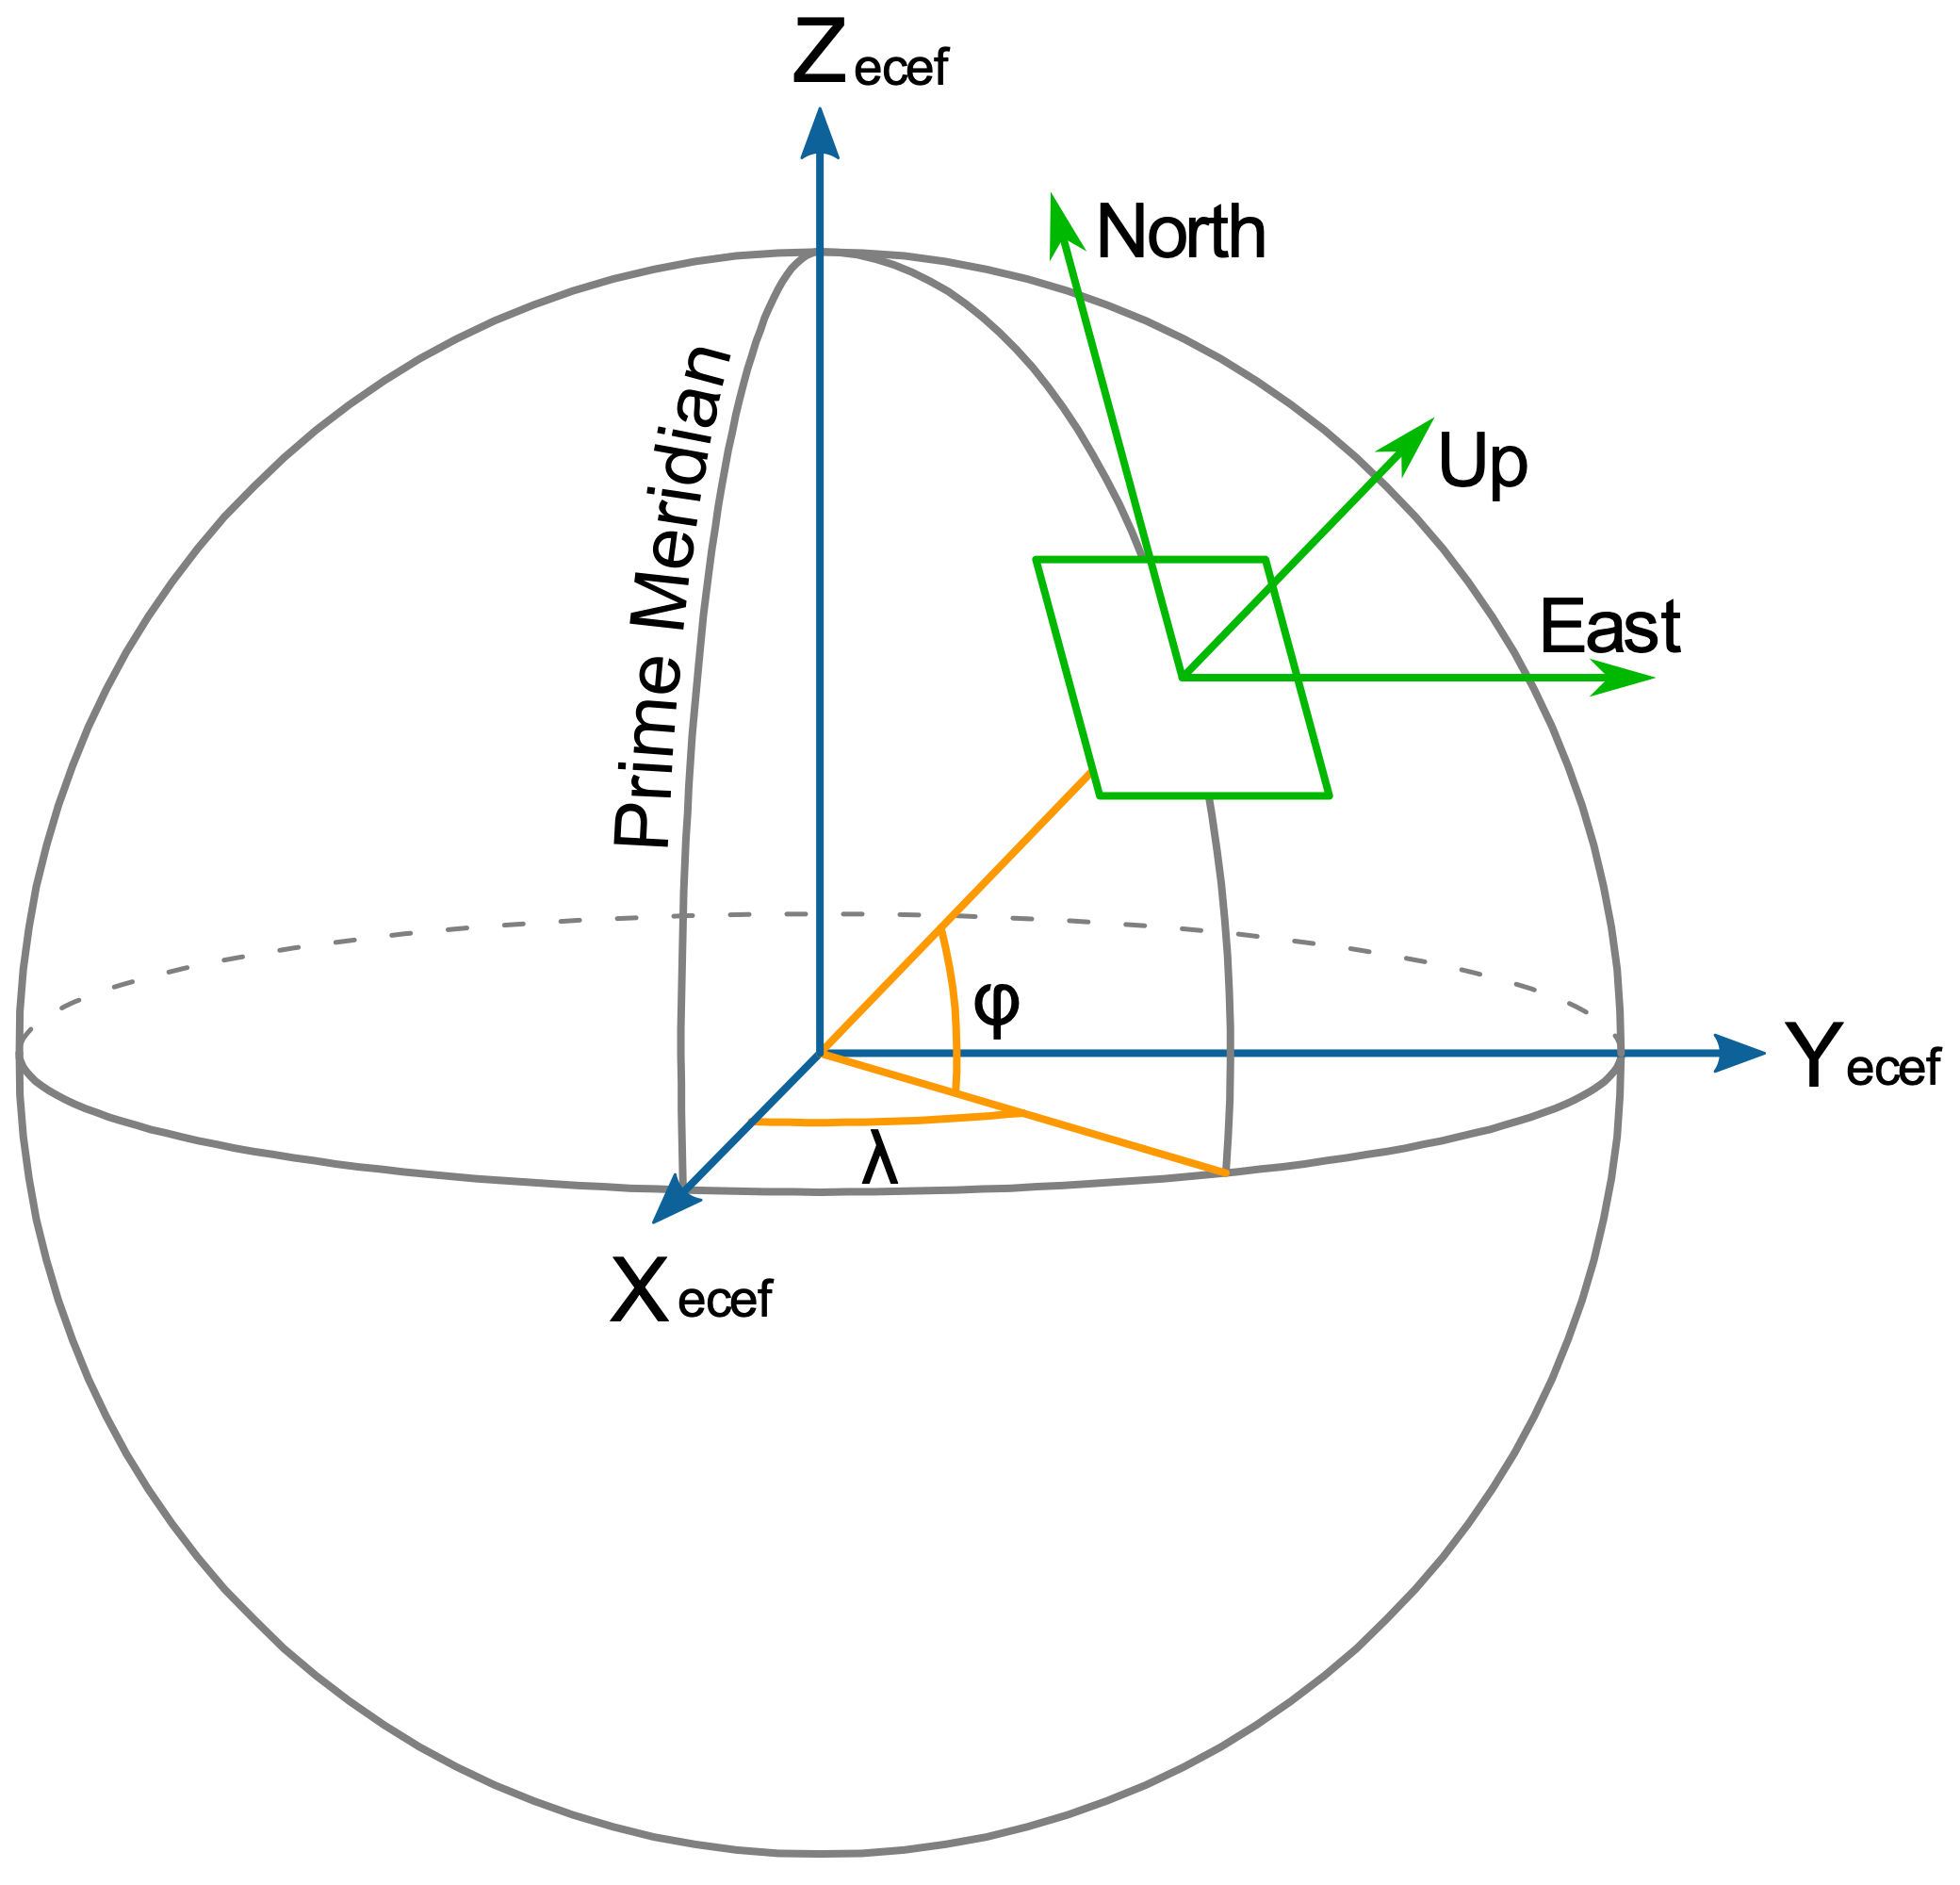

Coordinate Reference Systems
Coordinate Reference Systems (CRS) tie coordinates to real world places
Based on a Datum (geographic measurements of Earth and assumptions)
Golden rule: know thy data!
Combining datasets
Knowing what tools expect
Examples of coordinate reference systems:
WGS 84: US-centric, used for GeoJSON and most web data
Others: NAD 83, ITRF
Source: - Longitude and Latitude (left): By Mike1024 - Based on en:File:EarthTangentialPlane.png by en:User:Raffyl99 (public domain), Public Domain, https://commons.wikimedia.org/w/index.php?curid=9510652

Slide 8
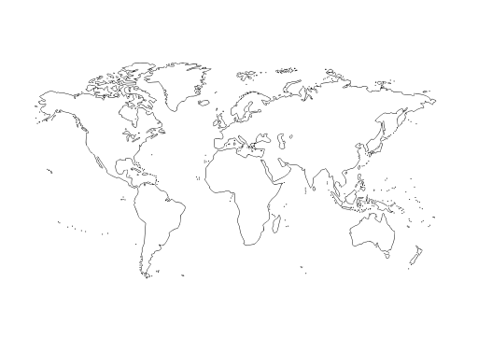
Projections: Translating 3D into 2D
A projection translates 3D coordinates into a 2D representation
All projections add an element of distortion
Different projections preserve/distort different aspects of the geographic features
Common projection: Spherical (or “Web”) Mercator
Used by most web tile providers
Source: - Projected map: molumen on the Open Clip Art Library, CC0, via Wikimedia Commons

Slide 9





Python Geospatial Packages
General: GeoPandas
Supporting Packages:
Fiona (vector I/O), Rasterio (raster I/O)
pyproj (CRS/projection transformations)
Shapely (implements GEOS geospatial functions)
Visualizations:
folium (leaflet.js)
matplotlib
contextily (web tiles)
Geocoding: geoPY

Slide 10
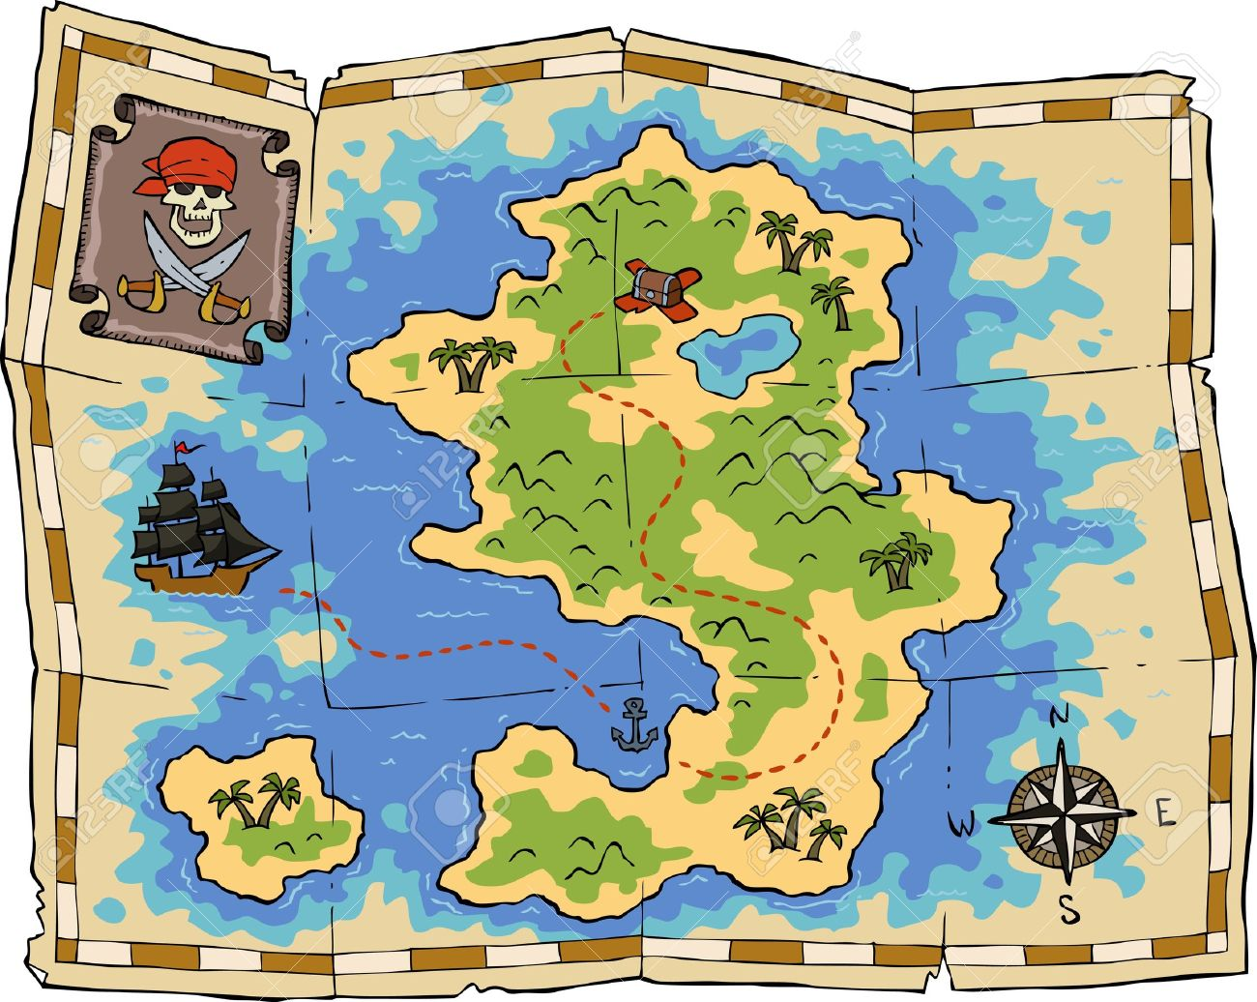
Code Demo Time!
Web Tiles
Python Magic
Data

Slide 11
APPENDIX A
Resources

Slide 12
Geospatial ‘Acronym Soup’ Quick Reference
Acronym
Full Name
Who/What It Is
OGC
Open Geospatial Consortium
Sets standards and protocols for the industry
OSGeo
Open Source Geospatial Foundation
Finances and maintains many open source geospatial projects
GDAL
Geospatial Data Abstraction Library
C++ library under OSGeo to handle file I/O for raster formats
OGR
Open GIS Reference Implementation
Part of GDAL; handles file I/O for vector formats
GEOS
Geometry Engine – Open Source
C++ library under OSGeo to implement geospatial functions
PROJ
PROJ
Software under OSGeo to make CRS and projection conversions
EPSG
European Petroleum Survey Group (now synonymous with registry itself)
Registry (and codes for) datums, spatial reference systems, and transformations

Slide 13
Resources
Eastern Search & Survey on Facebook:
https://www.facebook.com/Eastern-Search-Survey-109413857123876
Eastern Search & Survey free interactive Google map:
https://www.google.com/maps/d/u/0/viewer?mid=1dMRBuqZSxv1ULdiPi76ZQCiHB0OkW7NV&ll=40.306301090519035%2C-73.53378835388357&z=7
Original GitHub project repository:
https://github.com/Data-Science-for-Conservation/Ocean_GIS_for_Python
Documentation:
GeoPandas: https://geopandas.org/index.html#
Shapely: https://shapely.readthedocs.io/en/stable/manual.html
folium: https://python-visualization.github.io/folium/
Codes for most commonly used CRSs and projections:
www.spatialreference.org and https://epsg.io/
Get help via the GIS stack exchange
https://gis.stackexchange.com/

